Slide 1
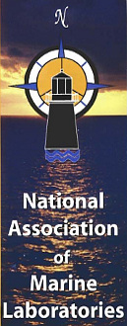
Regional Impacts of Ocean/Coastal Acidification
Briefing Conducted by the
National Association of Marine Laboratories
www.naml.org
Hosted by the
U.S. Committee on Commerce, Science and Transportation
United States Senate
October 22, 2014
Room SVC 203-02

Slide 2
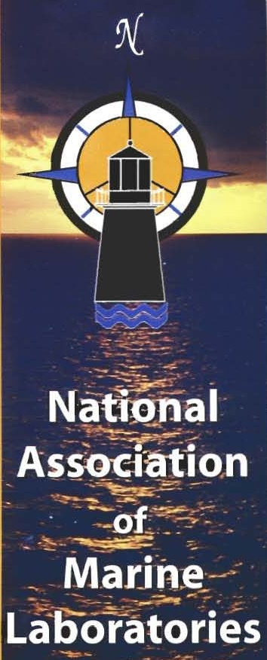
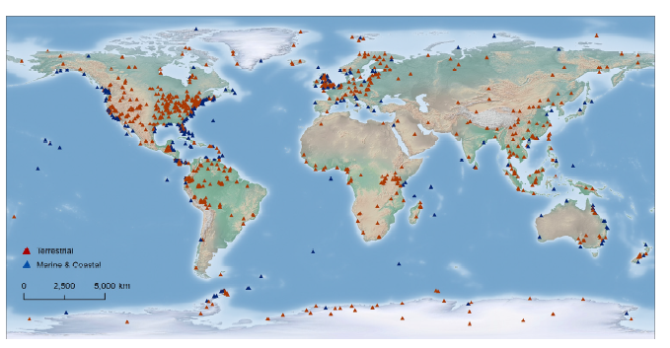
Map of Biological Field Stations and Marine Laboratories

Slide 3
Speakers
  Mr. Mike DeLuca, Manager, Jacques Cousteau National Estuarine Research Reserve, Director, NJ Aquaculture Innovation Center, Rutgers University;
  Dr. Roberta Marinelli, Director of the USC Wrigley Institute for Environmental Studies, University of Southern California, Los Angeles, California;
  Dr. Daniel McCorkle, Department Chair, Geology and Geophysics, Woods Hole Oceanographic Institution; and
  Dr. Louis Burnett, Professor, College of Charleston, Charleston, South Carolina;
  Mr. Daniel Cohen, President, Atlantic Cape Fisheries, Inc., Cape May, New Jersey

Slide 4
Ocean and Coastal Acidification: Implications for the West Coast of the United States
Roberta Marinelli
Director, Wrigley Institute for Environmental Studies
University of Southern California

Slide 5
Ocean/Coastal Acidification
    What is ocean and/or coastal acidification?
    Why is it happening?
    Why is this important?
    What are the public policy implications of increased levels of ocean acidification?
    How and why does the degree and impact of ocean acidification vary from coastal ecosystem to another?
    What can marine labs bring to the table to assist policy makers as they grapple with the local, state and regional challenges of ocean acidification?

Slide 6
Ocean Acidification and the West Coast
  Funding from the National Science Foundation is enabling marine labs from Washington State to Oregon to California to create a network to understand how OA will affect coastal regions of the western north America.
  What are the OA challenges facing the west coast and why are they different from other coastal areas?
    California current, rivers, and nutrient inputs contained within terrestrial run off

Slide 7
What Does This Mean for the West Coast?
  Many different marine animals, plants, and ecosystems up and down the west coast. Not to mention the 30 to 40 million people that live, extract their economic livelihood, nourish themselves, and recreate along the west coast.
  If our coastal waters experience water that comes from offshore upwelling, might our coastal organisms already be adapted to OA, i.e. able to cope with ongoing and increasing ocean acidification?
  Or, are important organisms such as coral, bivalves, and other shell-bearing forms, already at their limit, and unable to withstand the stress of increasing acidification?
  We don’t know enough at this point to say one way or the other – but it is a question state, local and regional pubic health, economic development and natural resource managers are asking.

Slide 8
What is Needed to Understand and Respond to Ocean Acidification?
  Long-term data on ecology and chemistry available though many marine field laboratories and also the ability to make new and more sophisticated measurements and observations to fill knowledge gaps.
  Use of marine labs as a network to provide a more integrated perspective that lets us evaluate how our coastlines and natural resources are changing as the ocean changes.
  Educate and train the next generation to be an informed citizenry so decisions that must be made on made with the appreciation of the complexity of our coastal environments.
  Use of this information by state, local and regional decision makers to make investment and management decisions in infrastructure and technologies to enable them to respond the emerging challenges of OA in their coastal region.

Slide 9
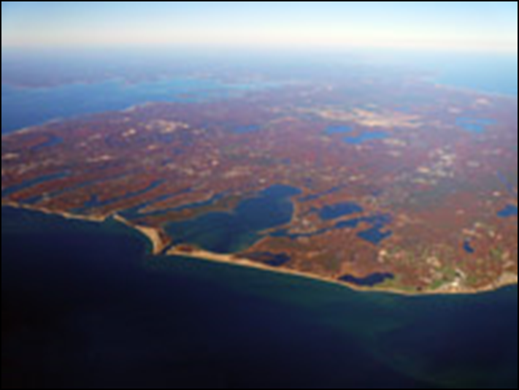
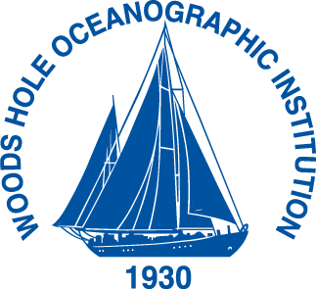
Acidification in coastal waters – an example from Waquoit Bay, Massachusetts
Daniel C. McCorkle
Woods Hole Oceanographic Institution

Slide 10
The basic story:
Rising atmospheric carbon dioxide levels are lowering the pH of the surface ocean globally.
(Ocean Acidification)
The carbon chemistry (e.g., pH) of bays and estuaries can be different from, and more extreme than,
the open ocean.
These differences reflect physical and biological processes that vary from site to site, and that help control acidification of coastal waters.
Sustained measurements in a range of environments (= multiple sites) are needed to understand acidification in coastal waters
(and the Great Lakes!)
Notes:
Take-home messages - No one-size-fits-all explanation for coastal acidification

Slide 11
Today:
Strong seasonal and daily pH cycles in bays and estuaries -
Location-specific natural processes
Water circulation & residence time
Biology (photosynthesis & respiration)
Location-specific human processes
Eutrophication (nutrient pollution),
modern and historical.
The challenge:
To understand these processes well enough to predict them, and their biological impacts.

Slide 12
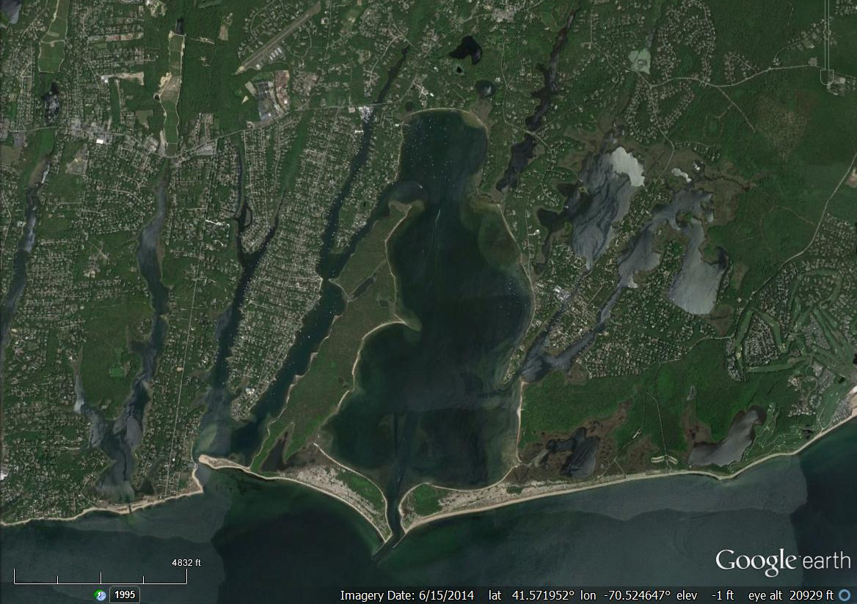
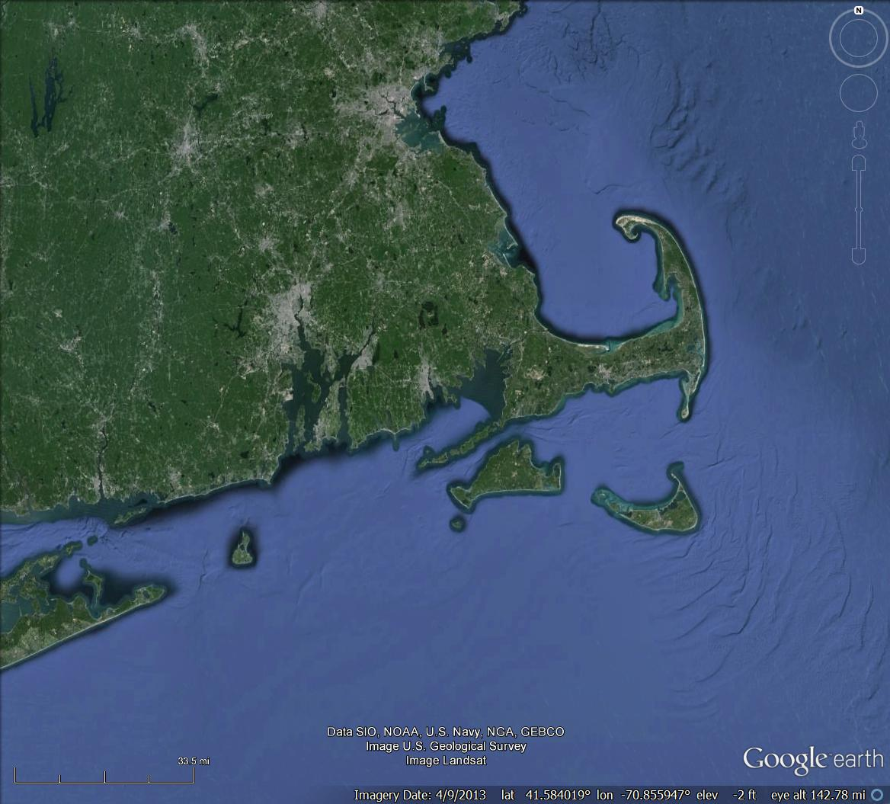
Waquoit Bay, MA
Growing year-around residential occupancy
A range of recreational uses – boating, fishing, shellfishing
Commercial uses include shellfishing and shellfish aquaculture
Notes:
Our local poster child

Slide 13
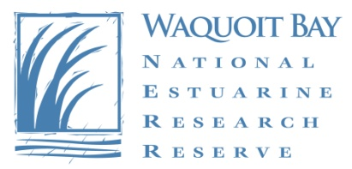
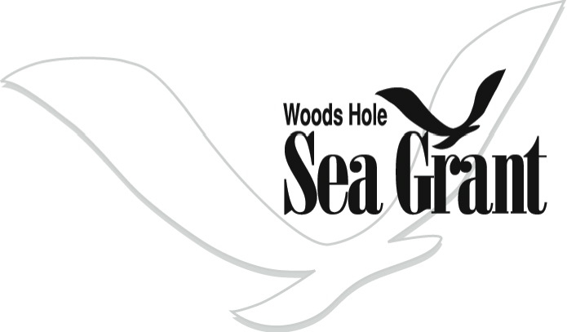
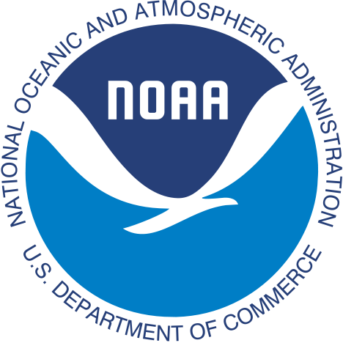
Waquoit Bay is home to a National Estuarine Research Reserve – one of 28 sites in the nationwide NOAA - NERRS system.
Sustained research at a network of place-based sites is essential to understanding acidification in coastal waters, and its impacts on coastal processes and resources.

Slide 14

Waquoit Bay National Estuarine Research Reserve sample sites.
Childs River
mooring
Menauhant
Three quick slides:
1. Monthly pH and CO₂ data from two NERRS System-Wide Monitoring Program (SWMP) stations - Childs River and Menauhant
2. High-resolution in situ data from mooring station at head of bay
3. Dissolved oxygen data from continuous monitoring sensors at the two SWMP stations
Notes:
A quick look, to illustrate the variability, and its causes.

Slide 15
Four-year time series of Waquoit Bay pCO₂ and pH.
Today’s atmosphere – 400 ppmv
Typical open-ocean pH ~ 8.1
(these early-morning, low-tide samples catch the lowest pH values of the day)
1. We observe dramatic seasonality
Summer pH and pCO₂ values in Waquoit Bay far-exceed predictions of end-of-century open ocean acidification.

Slide 16
Automated high-frequency in situ pH and total carbon analyses show the influence of local biological processes in Waquoit Bay.
2. Photosynthesis and respiration drive strong day/night cycles of pH and CO₂, with high pH during the day, and night-time pH values lower than end-of-century open ocean predictions.
Notes:
The key point is that the daily range (in summer) is comparable to the observed seasonal range.

Slide 17
Dissolved oxygen and pH co-vary
3. Nutrient pollution causes algae to “bloom” and sink.
The decomposition of those algae consumes oxygen and releases CO₂, causing low pH.
Marine life – e.g. larval shellfish – are affected by both stressors:
acidification and low oxygen.
Notes:
Finally, point out that OA is linked to oxygen; both OA and low O2 are stressors

Slide 18
Controls on carbonate system chemistry (e.g. pH) of coastal waters include processes that are variable, and often site-specific:
- Water circulation / “flushing time”
- Natural cycles of
Biological uptake and release of carbon dioxide (photosynthesis & respiration/decomposition)
Groundwater discharge (fresh and saline) and groundwater chemistry
- Human perturbations to these cycles
These processes can result in local acidification that is much stronger than projected 21st century global ocean acidification.
These processes need to be studied in multiple settings, so that their interactions and relative importance can be compared, and used to develop predictive models.
Are coastal and estuarine ecosystems pre-adapted to high carbon dioxide, or pre-stressed?

Slide 19
Ocean Acidification in Southeastern Coastal Waters
Louis E. Burnett
Professor of Biology
College of Charleston
President, Southern Association of Marine Laboratories
BurnettL@cofc.edu

Slide 20
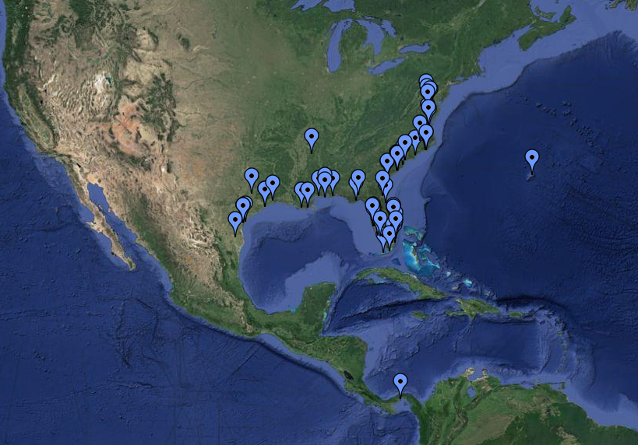
Region of the
Southern Association of Marine Laboratories (SAML)
Notes:
Region encompasses a broad range of ecosystems.

Slide 21
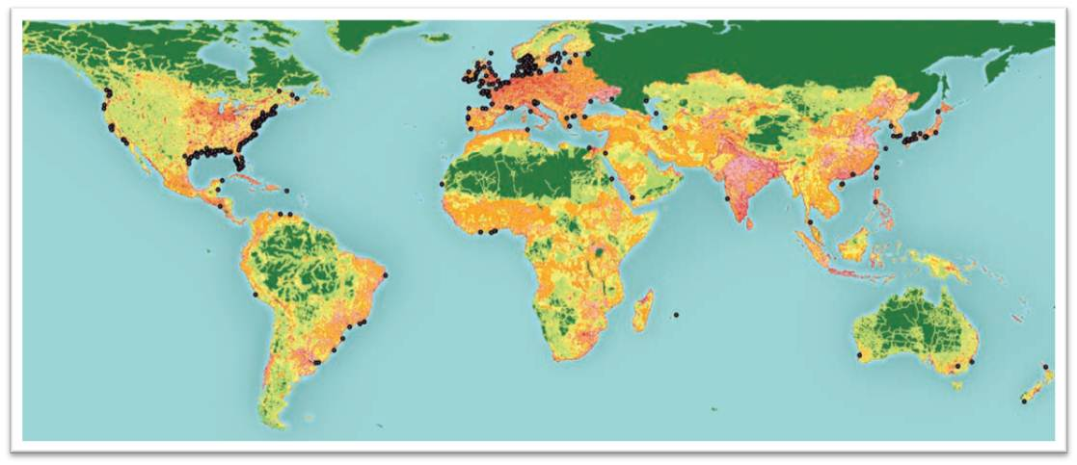
Documented zones of low oxygen
Diaz and Rosenberg, 2008
Notes:
We know setiferus (and aztecus) are exposed to hypoxia as shown above, but setiferus don’t appear to change O2 affinity in response to chronic hypoxia. Would be less energetically expensive than increasing [hc] (which they do), so does that mean it’s a bad thing??? Also know they are active, maybe need more of a venous reserve? But then why do vannamei do it? …we’ve reached a loop in our reasoning here…future directions aimed at clarifying what’s going on in vannamei.

Slide 22
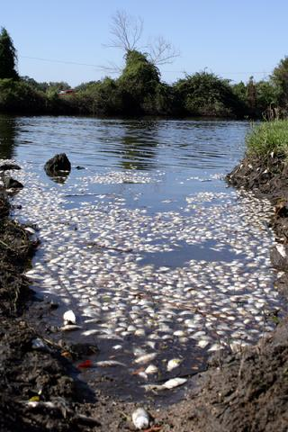
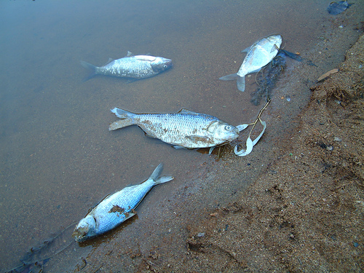
Fish Kills
http://thewatchers.adorraeli.com/
http://www.riverlaw.us/fishkills.html

Slide 23
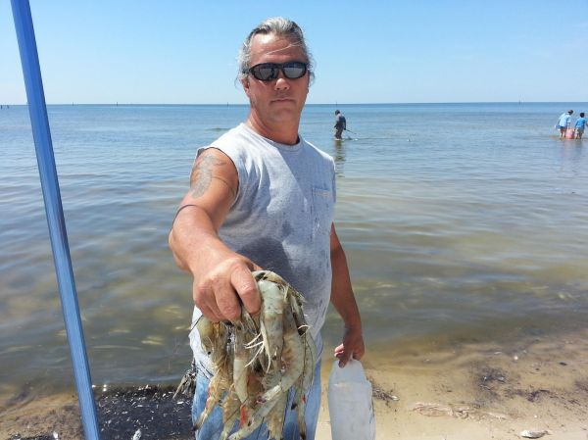
Jubilees
http://www.wlox.com/story/22730148/jubilee-fish-kill-lures-families-to-beach-for-easy-to-catch-seafood

Slide 24
Low oxygen, the insidious killer……………..
Nearly always accompanied by elevated CO₂.

Slide 25
Ocean Surface Water
 | pH | CO₂ (µatm)
preindustrial | 8.2 | 250
present | 8.1 | 390
2100 | 7.7 – 7.8 | 700-1000

Slide 26
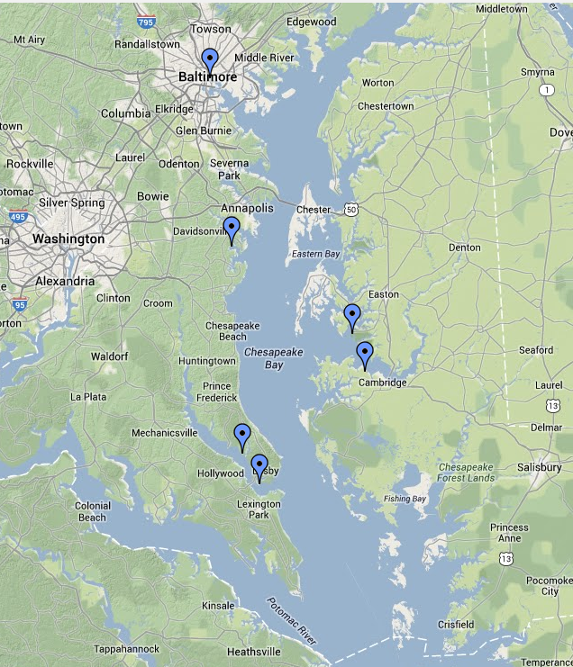
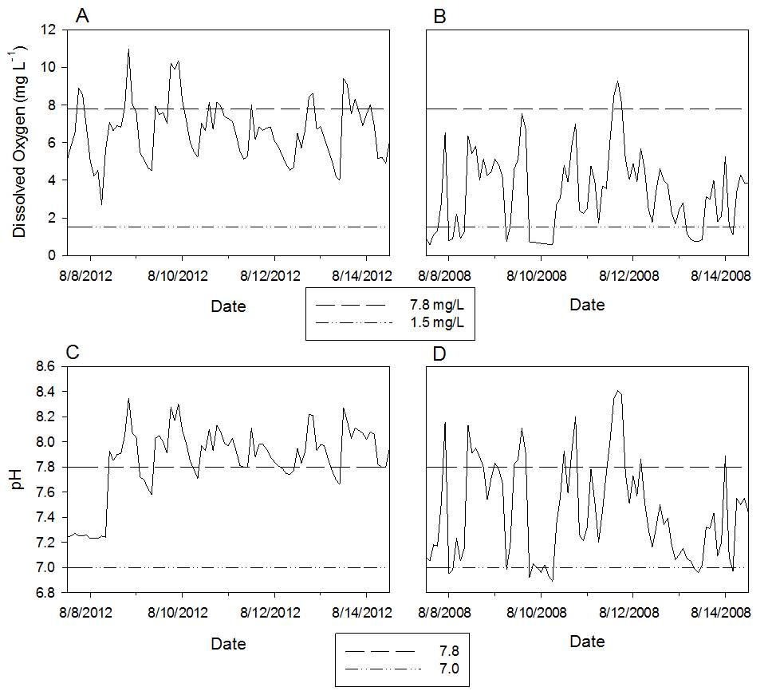
Diel cycling of low oxygen and pH
St Mary’s College, St. Mary’s River
Possum Point, Corsica River
Data from MD DNR’s EyesOnTheBay.net
Slide adapted from Masters Thesis Defense
Virginia Clark, U. of Maryland

Slide 27
Coastal South Carolina Water for example
 | pH | CO₂ (µatm)
preindustrial | 8.2 | 250
present | 8.1 | 390
2100 | 7.7 – 7.8 | 700-1000
present | 6.0-8.1 | 300->20,000
Notes:
Will touch upon larval responses and responses of whole organisms such as oysters, shrimp, and crabs to low oxygen and elevated carbon dioxide.

Slide 28
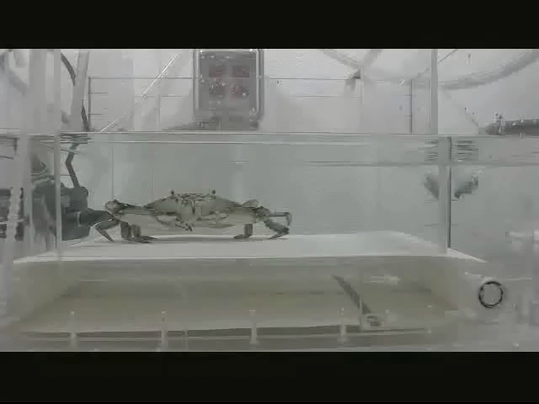
Blue Crab Performance

Slide 29
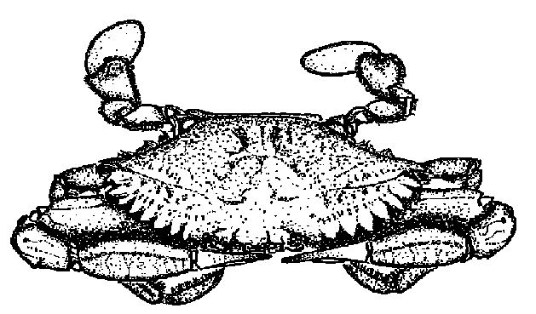
Fatigue Behaviors in Blue Crabs
20% air sat.
50% air sat.
100% air sat.
Stover et al. 2013

Slide 30
Fatigue Behaviors in Blue Crabs
20% air sat.
50% air sat.
50% air sat. + 2% CO₂
100% air sat.
Stover et al. 2013

Slide 31
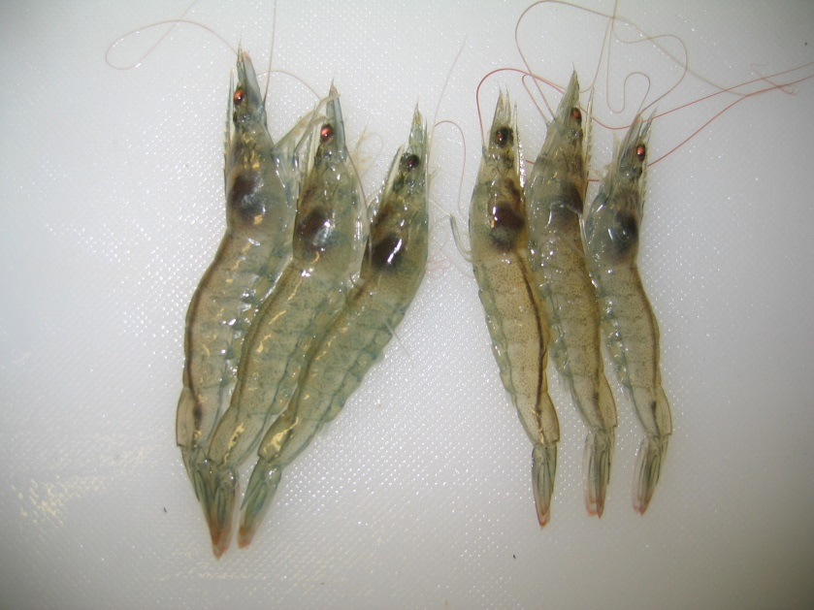
A BIG Problem
Many organisms can adapt to low oxygen, even and especially humans.
BUT this adaptation is muted with elevated CO₂!
Pacific Whiteleg Shrimp
Litopenaeus vannamei

Slide 32
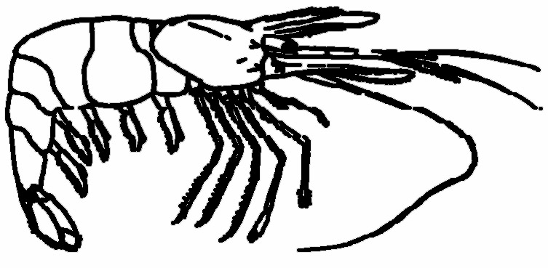
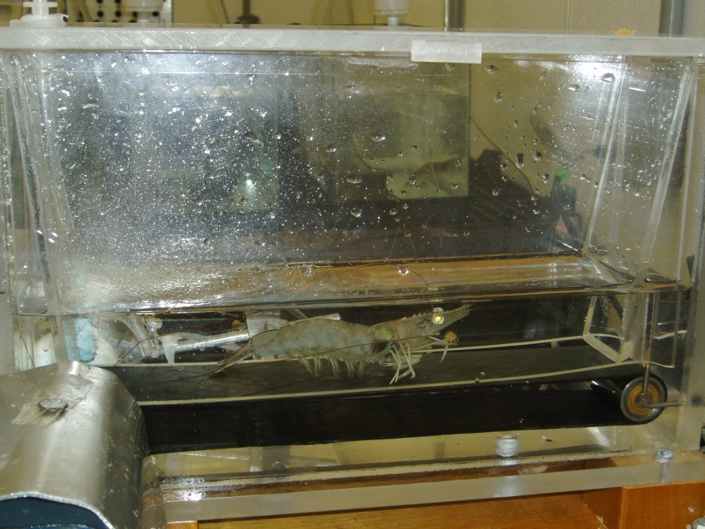
Pacific Whiteleg Shrimp
Genes to make blue blood are turned on within 24 hours on exposure to low O₂.
HOWEVER, exposure to CO₂ mutes this response to low O₂ (Rathburn et al., 2013).

Slide 33
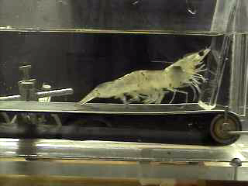

Slide 34
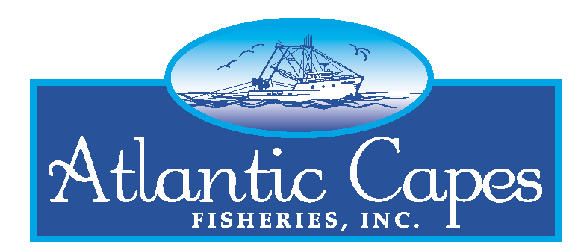
Impact of Coastal Acidification on Shellfish Farming with Implications for Wild Fisheries
Daniel Cohen, President
Cape May, NJ 08204
www.atlanticcapes.com
www.capemaysalts.com
www.islandscallops.com

Slide 35
Impact of Coastal Acidification on Shellfish Farming
Coastal acidification is already affecting hatchery-produced shellfish.
Pacific Northwest oyster industry lost at least $110 million due to coastal acidification
In 2013, 90% mortality was experienced in three year classes of scallops in NA largest scallop farm (2010, 2011, 2012).
Shellfish larvae and juveniles are particularly susceptible

Slide 36
Impact of Coastal Acidification on Shellfish Farming
Shellfish Response to Acidification
  Decreased fertilization rates
  Decreased hatching success
  Decreased larval growth
  Shell deformities
  Impacts on shell formation
  Weakening of shell

Slide 37
Impact of Coastal Acidification on Shellfish Farming
Current Industry experiments in adaptation:
Hatchery and nursery intake water monitoring and buffering seawater (the “TUMS” approach)
As volume of water increases in nursery this becomes more challenging
Buffering the coastal waters for grow-out operations clearly is a different scale challenge

Slide 38
Impact of Coastal Acidification on Shellfish Farming
Key Steps for Research and Adaption
  Establishment of standardized monitoring and collection of data in Aquaculture , Coastal waters, and Ocean Waters
    http://oceanhealth.xprize.org
  Selective breeding to select for shellfish that can survive in increasingly acidic water
    Similar to breeding of disease resistance
    Can now for first time use new genomic tools
  Capitalize on research networks
    Coordinate nationally and Internationally
    Leverage shared problems and collaborate on research
    Support demonstrations of adaption in the field

Slide 39
Implications for Wild Fisheries
Aquaculture hatcheries control the environment and we can see the impact of acidification – immediately at spawning
Wild fisheries are conducted in open ocean - Spawning events are not observed
Success of spawning often not known for about 1-2 years until shellfish is large enough to sample in NMFS surveys

Slide 40
Implications for Wild Fisheries
There is no existing data base of PCO2 or pH on the ocean bottom or water column
Current coastal monitoring shows PCO2 levels in multiples of atmospheric CO2
Ocean modeling needs to consider:
  Is the World experiencing a combination of atmospheric PCO2 and climate change
  Ocean Temperature changes causing changing in ocean currents and upwelling binging up “ancient PCO2
Impacts on populations of “carbonate shellfish” can be postulated from aquaculture, but are really unknown in the open ocean
US shellfisheries have a multi-billion dollar plus impact to the US economy

Slide 41
Implications for Policy
First: Stop the source of CO2
  Save a Fish: Wear a Condom
  Reduce Society’s Carbon Footprint
Second: If we can’t stop the source of Ocean Acidification, how can we adapt?
  Need to monitor to know
  Need to selectively breed marine species which can thrive in an increasingly acidic environment

Slide 42
Impact of Coastal Acidification on Shellfish Farming with Implications for Wild Fisheries
QUESTIONS?
Daniel Cohen, President
Cape May, NJ 08204
www.atlanticcapes.com
www.capemaysalts.com
www.islandscallops.com

Slide 43
Regional Impacts of Ocean/Coastal Acidification
Briefing Conducted by the
National Association of Marine Laboratories
www.naml.org

